Slide 1
Supervised Learning 1
Rayid Ghani
Slides liberally borrowed and customized from lots of excellent online sources

Slide 2
Recap from last class: ML Process
Problem Formulation
Process Data
Explore Data
Deeper Analysis (Modeling)
Store Data
Evaluate
Deploy and Maintain
Get Data
Link Data

Slide 3
Types of Learning
Unsupervised
Clustering
PCA
…
Supervised
Classification
Regression
…
“Weakly” supervised

Slide 4
Unsupervised Learning
No outcome or dependent variable is present
Goal is exploration, understanding historical data, finding patterns and/or groups in the data
Examples
Clustering (cluster analysis)
Principal Components Analysis
Association Rules (beer and diapers)

Slide 5
Supervised learning framework
y
= f( )
X
output
“Learned”
function
Features/Predictors
future/generalization
Training or Learning: Find an f that minimizes error in recovering y
Slide credit: L. Lazebnik

Slide 6
Supervised learning framework
y
= f( )
X
output
“Learned”
function
Features/variables/inputs/predictors/independent variables
Training: Given a training set of labeled examples {(x₁,y₁), …, (x_{N},y_{N})}, estimate the prediction function f that minimizes future generalization (out of sample) error
Scoring/Testing: apply f to a new example x and output the predicted value y = f(x)

Slide 7
How to solve a supervised learning problem
Define and Create label (outcome variable)
Define and Create Features (predictors)
Create Training and Validation Sets
Train model(s) on Training Set
Validate model(s) on Validation Set

Slide 8
Modeling/Learning Steps
Training
Features
Training
Learned model
Training Data
Labels/Outcomes

Slide 9
Modeling/Learning Steps
Testing/Validation
Apply Model
Test Data
Features
Predictions
Labels
Evaluate
Metrics

Slide 10
Methods
Nearest neighbor
Decision Trees
Logistic Regression
Support Vector Machines
Bayes Classifier
Ensembles
Bagging
Boosting
Random Forests
Neural Networks
We’ll cover these two in class today

Slide 11
Things you want to know about a method
What assumptions does it make about the data?
What is it optimizing for?
How to train it?
What parameters does it have?
How to select those parameters?
How to use it to score new data?
How to interpret the model and the predictions?

Slide 12
Some dimensions to compare supervised learning methods
Efficiency
Training
Scoring
Robustness to noise in the data
Robustness to violations of assumptions

Slide 13
Simplest classifier

Slide 14
Classifiers: Nearest neighbor
x
x
x
o
x
x
x
o
x
o
x
o
o
o
o
New data point
f(x) = label of the training example nearest to x
All we need is a distance function for our inputs
No training required!
Slide credit: L. Lazebnik

Slide 15
K-nearest neighbor
x
x
x
o
x
x
x
+
o
o
x
x
o
o
+
o
o
x2
x1

Slide 16
1-nearest neighbor
x
x
x
o
x
x
x
+
o
o
x
x
o
o
+
o
o
x2
x1

Slide 17
3-nearest neighbor
x
x
x
o
x
x
x
+
o
o
x
x
o
o
+
o
o
x2
x1

Slide 18
5-nearest neighbor
x
x
x
o
x
x
x
+
o
o
x
x
o
o
+
o
o
x2
x1

Slide 19
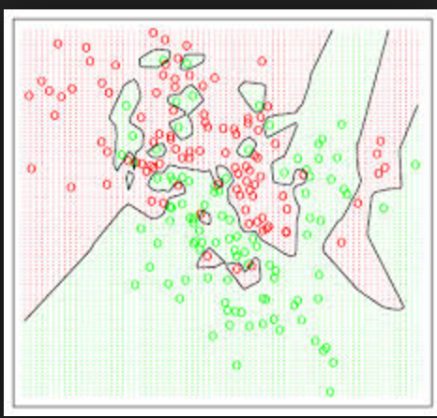
Voronoi Diagrams
Given a set of points, a Voronoi diagram describes the areas that are nearest to any given point.

Slide 22
K-NN: Benefits
Simple to use
Fast to train
Doesn’t make assumptions about data distribution

Slide 23
When would kNN not work?

Slide 24
K-NN: Problems
Need to figure out the right distance function
Slow at scoring/prediction time
Need to store all the data

Slide 25
Bonus Questions
Does it matter if you scale the variables/features?
What if you have a lot of irrelevant or correlated features?

Slide 26
Classifiers: Decision Trees
# of Previous Spells
Average length of Spell
Class: Negative prob = 2/100
Class: Positive prob = 32/50
Average length of Spell
Class: Negative prob = 18/60
Class: Positive prob = 84/120
<=2
>2
<=90 days
>90 days
< 30 days
>= 30 days

Slide 27
What do we need to build a tree?
How to create a split?
When to stop?

Slide 28
How to create a split?
Which of the many features/predictors/variables do we choose to split?
What do we want the split to result in?
Purity of the leaf node
How do we measure purity?

Slide 29
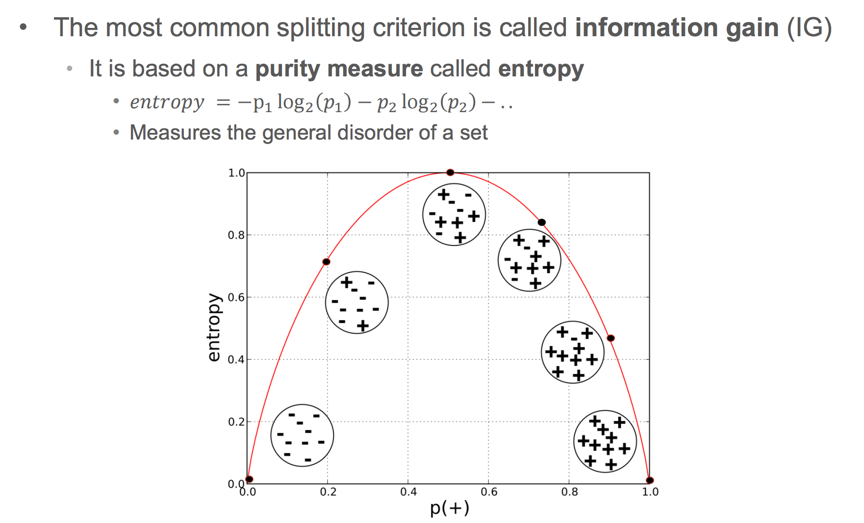
Information Gain

Slide 30
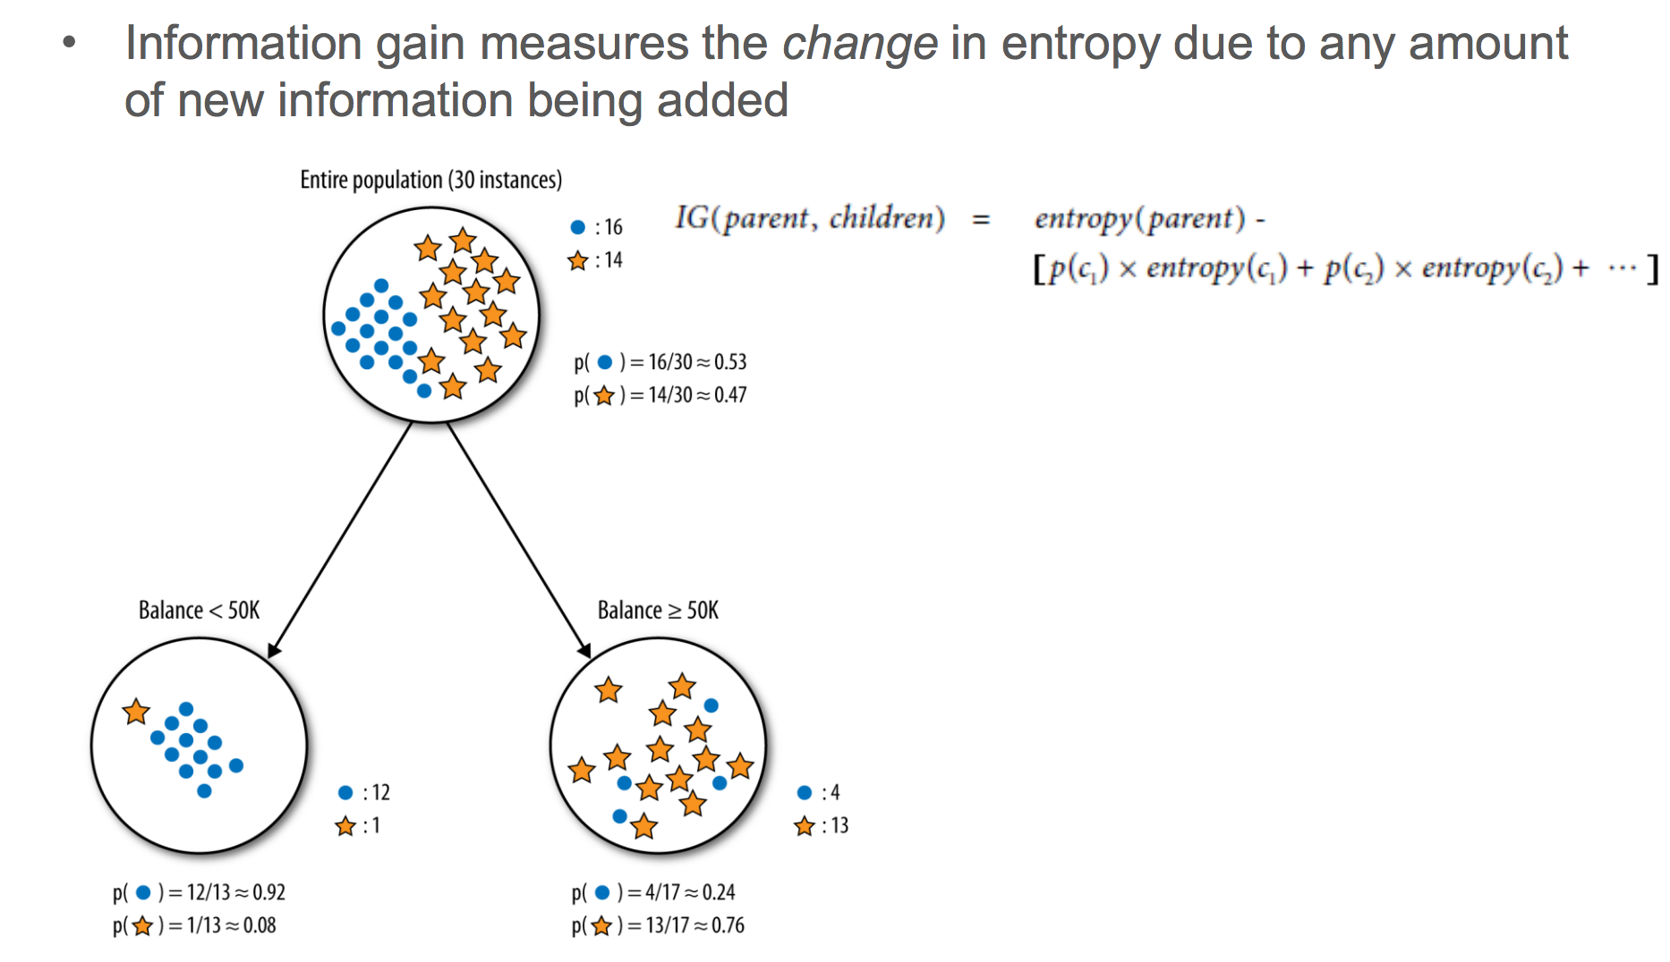
Information Gain

Slide 31
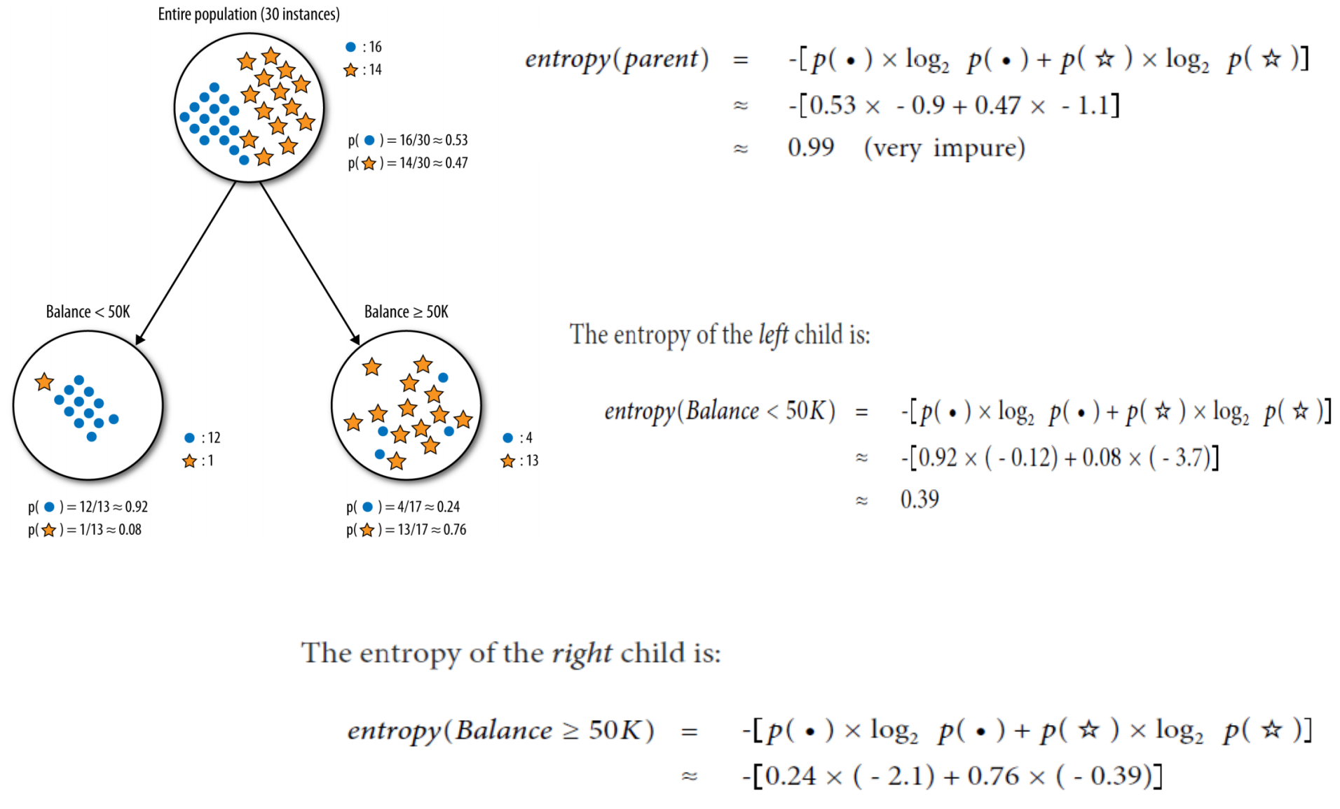

Slide 32
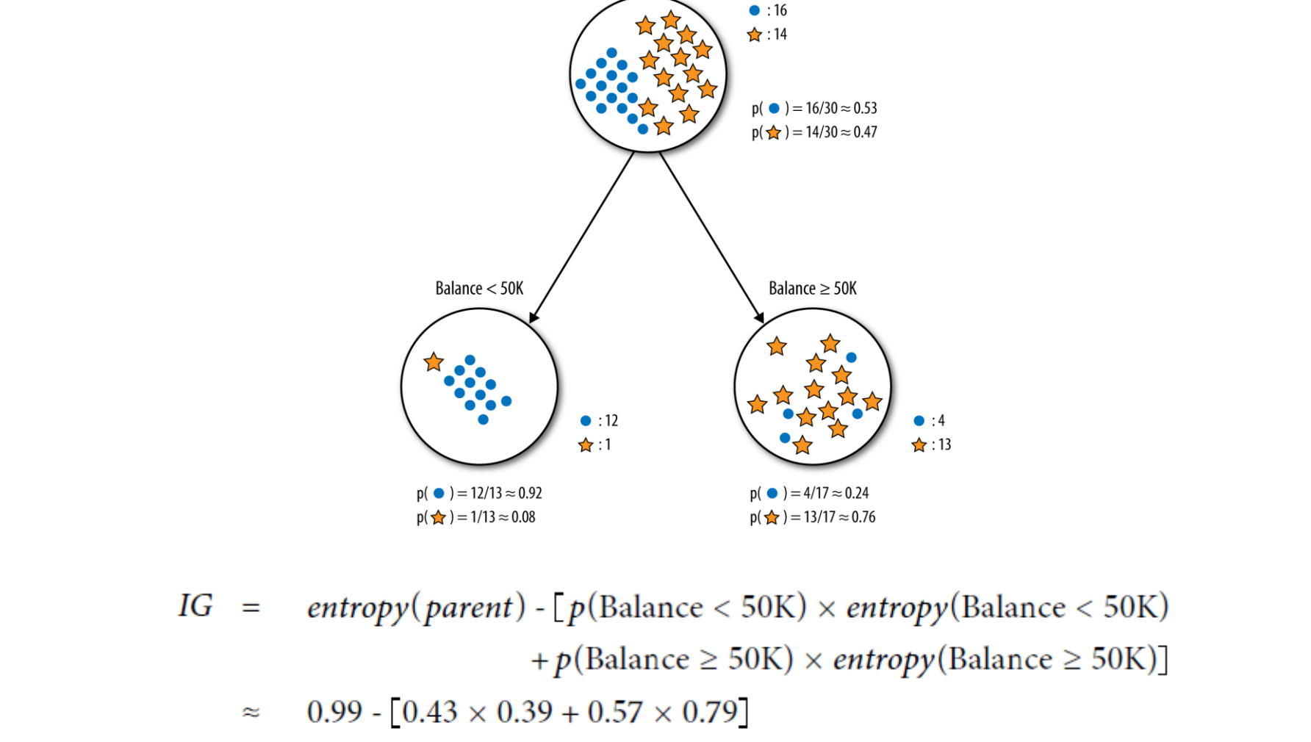

Slide 33
Decision Tree: Algorithm

Slide 34
Different Representations
# of Previous Spells
Average length of Spell
Class: Negative prob = 2/100
Class: Positive prob = 32/50
Average length of Spell
Class: Negative prob = 18/60
Class: Positive prob = 84/120
<=2
>2
<=90 days
>90 days
< 30 days
>= 30 days

Slide 35
Different Representations
30 60 90 120
Average length of Spell
1 2 3 4
# of Previous Spells

Slide 36
Different Representations
If
Then
Else
If

Slide 37
Stopping Criteria
Depth
Minimum # of samples for splitting
What else can we do?

Slide 38
Decision Trees: Pros and Cons
Pros
Possibly easy to understand (if small)
…?
Cons
Unstable: Sensitive to small changes in data
(Usually) Not very accurate

Slide 39
Common uses of Decision Trees
Sanity Checks
Baseline

Slide 40
Questions to think about
When would decision trees not work well?
How would you do regression using a tree?
Is any special data prep required for trees?

